Slide 1
2022 Fourth Quarter Outlook
Is the Fed Fighting the Ghost of Inflation? | Enter Date
--Rep Name
--Firm-Approved Title
--Registered Branch Address
--Approved Email and/or Registered Phone
--Securities Disclosure
Enter all information above and submit to Ad Review for final approval
Notes:
Introduction

Slide 2
Themes for the Fourth Quarter
Risk of Fed policy error (recession) increasing
Recession may be mild
Market volatility will remain elevated
Notes:
Our third quarter themes continue into the fourth quarter as inflation and the Federal Reserve (Fed) continue to dominate investors’ minds. With inflation continuing to remain stubbornly high, yet with underlying signs it is fading, the risk of the Fed overtightening and raising interest rates too fast and too high is also rising. This is what we described in our last quarterly outlook as a “hard landing.” Rising interest rates increases borrowing costs and slows the economy. If the Fed raising rates more than is necessary, it is hurting the economy more than needed and possibly causing a recession. Put simply, a recession is a significant decline in economic activity.

Slide 3
Inflation vs The Fed
Notes:
The Fed is playing catch up and raising rates at the fastest pace since the early 1980s. Before the most recent rate hike of 0.75%, the overall Fed funds level was the same as the peak in the prior cycle. However, it had taken three years to get to that level and in 2022 this level was achieved in only four months. With this fast pace of rate hikes, the risk of raising rates too high and causing a recession are rising.

Slide 4
Inflation is broad-based
Notes:
Data can be very complicated and the size of the U.S. economy at nearly $25 trillion only makes things more difficult. Inflation data isn’t as clear cut as you might think. There are many different inflations measures too. While we often hear about CPI in the news, the Fed’s preferred inflation metric is the Personal Consumption Expenditure Price Index (PCE). One can also look at data that looks at the mean (or average), median (or middle) or even the mean stripping out outliers to the downside and upside. This can be a good gauge of how widespread inflation is in the economy or if it is just being caused by a few specific categories such as housing or energy. If we look at the 16% Trimmed-Mean Consumer Price Index published by the Federal Reserve Bank of Cleveland, we can get a better feel if inflation is more broad-based. This inflation index takes all the inflation categories and strips out the top and bottom 8% and then reports the mean (average). As illustrated in the chart below, you can see that this index is still relatively high compared to the past and it rose in August. While some major headline inflation items, like oil prices, are falling, inflation is rising on a very broad level across the economy, unfortunately.

Slide 5
Commodity Prices
Notes:
To understand why we think the Fed will eventually pivot to be less aggressive, let’s look more closely at the inflation data. While inflation has been surprising to the upside, there are underlying signs inflation may be easing.
Oil prices fell nearly 7% in August. This is important because oil impacts almost all areas of the economy because goods are transported by ship, plane and truck and rely largely on gasoline, which was down over 10% in August. Additionally, oil impacts food prices even more because food not only needs to be transported but crops rely on fertilizer, another petroleum-based product. Underlying commodity prices that were elevated have been falling.

Slide 6
Transitory CPI Categories
Notes:
Major categories that were pushing inflation higher also started to abate.

Slide 7
Rising Inventories
Notes:
Also adding to the thesis that inflation may be easing soon is retail inventories. Inventories dropped to extremely low levels last year but now are rising quickly for many types of businesses (auto sector is on exception). This is because supply chains are normalizing and with that freight costs are falling. Shipping delays from last year resulted in excess inventories this year for many consumer products. Businesses will eventually have to get rid of these inventories to make room for new products and this often means discounts are coming. This could be good news for consumers as we enter the holiday season.

Slide 8

Inflation is Personal
Notes:
Some of you might be surprised by the recent inflation readings, thinking that inflation should have dropped last month, and you aren’t alone. That’s because inflation indexes measure inflation across the entire economy, but inflation for individuals and families is very personal. We all buy different baskets of goods and services. The inflation we all experience will be different. With that said, inflation may have felt strong depending on your individual basket.
Electricity and natural gas, new vehicles, shelter, education, and medical care all contributed to a higher CPI figure in August. If you did not buy a new car, visit a doctor, or renew an apartment lease last month, your personal inflation was probably not as bad.

Slide 9
Leading Indicators
Notes:
Forward looking data, or leading indicators, still point to expansion and not contraction of the U.S. economy. August surveys of different business decision makers was promising. The Institute of Supply Management (ISM) Manufacturing Purchasing Managers Index (PMI) was 52.8 and ISM Services PMI was 56.6. Anything over 50 indicates expansion. Moreover, the new orders index for both these indices increased in August.

Slide 10
Labor Market
Notes:
The labor market remains resilient. There are 2 more job openings for every unemployed worker. Additionally, people are still quitting at a high rate. People don’t generally quit unless than can find higher pay elsewhere. Fed Chair Powell mentioned this metric in his FOMC speech. The Fed wants to bring down labor inflation and is also looking at this metric closely.

Slide 11
Consumer Spending
Notes:
Consumer spending remains around 70% of the total U.S. economy, so we can’t understate its importance. Retail spending is 30% above pre-pandemic levels but has been trending lower on an inflation-adjusted basis since the spring of 2021. If we get a reprieve in inflation this could help real spending, and if the labor market remains strong, we expect spending growth to continue.

Slide 12
Confident Consumer
Notes:
Consumer confidence in August finally increased after three consecutive months of declines. Consumer optimism increased on both their current situation and expectations about the future. Gasoline prices can have a large influence on consumers, so falling gas prices probably helped improve their optimism.

Slide 13
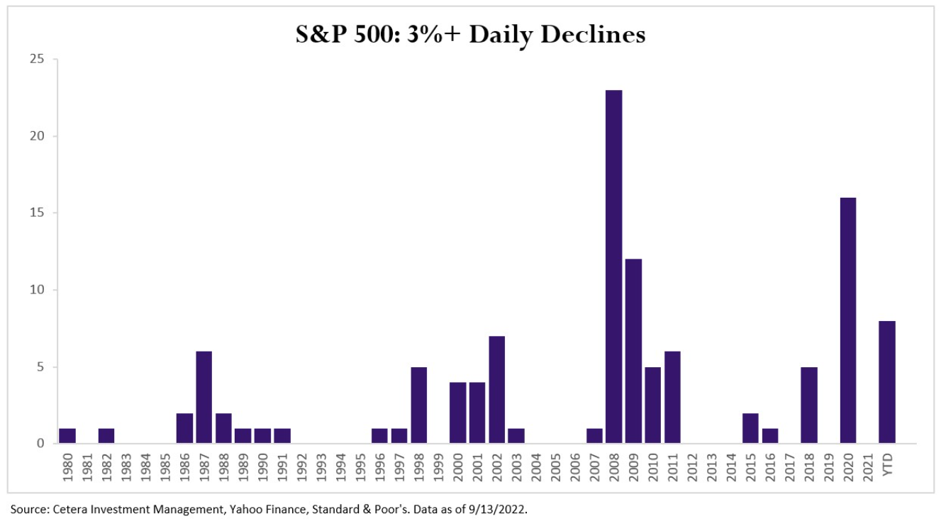
Number of S&P 500 Daily Declines Over 3%
Notes:
The third quarter was really a tale of two halves for stock markets. The S&P 500 had rallied 17.4% from mid-June to mid-August but seemed to hit a wall, falling more than 10%, after it approached its 200-day moving average. As of the time of this writing, the S&P 500 had eight days in which it declined more than 3% in 2022. Since 1980, only three years had more declines over 3% (2008, 2009 and 2020).
Good news for stocks:
Valuations as measured by P/E ratios are closer to their 20-year averages in large caps and close to 20-year lows in small caps.
Earnings estimates have been revised down, making upside surprises more easily obtained
Other central banks have started to raise rates and if the dollar starts to fall, this could be a tailwind for U.S. multi-national companies with revenue overseas.

Slide 14
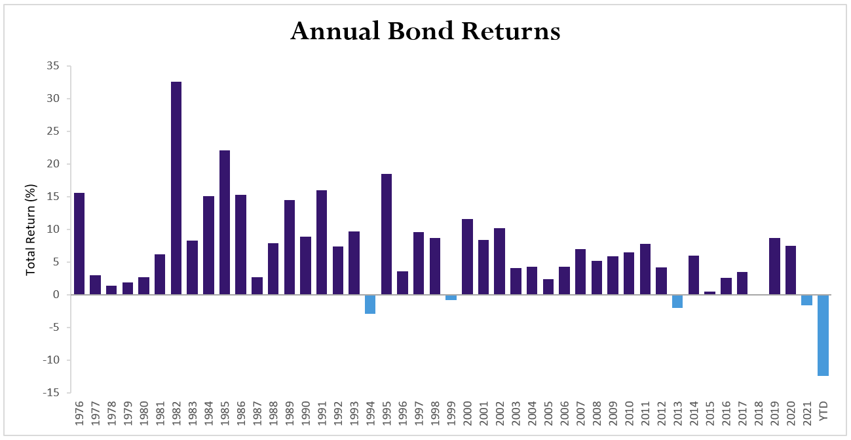
Calendar Year Bond Returns
Source: Cetera Investment Management, Morningstar, Bloomberg. Bond returns are total return based on the Bloomberg US Aggregate Bond Index. Data as of 9/22/2022.
Notes:
Equities were not the only volatile asset class this quarter. Bonds continued their rocky path. The 10-year Treasury yield peaked out at 3.49% on June 14th before bottoming at 2.60% on August 1st. Yields move inversely to prices, so this equated to a gain in the Bloomberg U.S. Aggregate Bond index of over 5.5%. Since August 1st, yields have rose to over 3.50% again causing a drop of over 5%. A 10% swing in roughly 90 days in this index is unprecedented. As it stands now, the index is down over 13% year-to-date, by far its worst year on record going back to 1976. Its previous worst year was 1994 when the index was down less than 3%.
With this backdrop, many bond investors are unsure about their allocations. However, there are some positives with bond yields rising and bond prices falling. The additional yield in both Treasuries and corporate bonds cushions a potential drop in price if yields move higher, or credit spreads widen. Bonds can also protect against equity volatility, so should be viewed in the context of a well-diversified portfolio. When constructing a bond portfolio, your financial professional can help you build a portfolio that suits your specific goals and objectives.

Slide 15
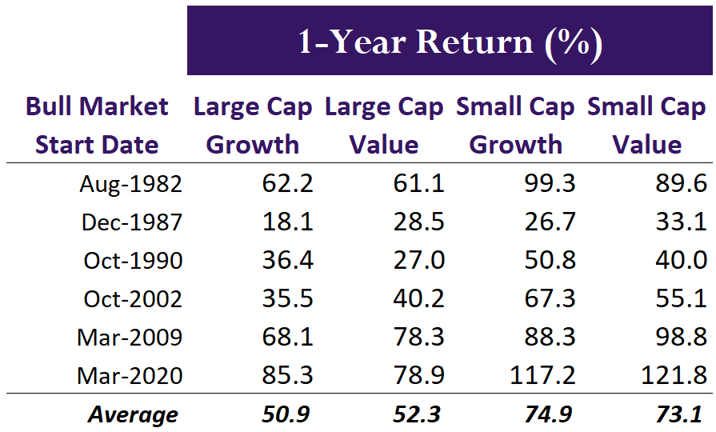
Markets Are Forward-Looking
Source: Cetera Investment Management, Morningstar, Russell Investments. Returns shown are total return, which includes dividends. Large cap stocks are represented by the Russell 1000 index. Small cap stocks are represented by the Russell 2000 index.
Notes:
Market returns are historically lower than the last bull market

Slide 16
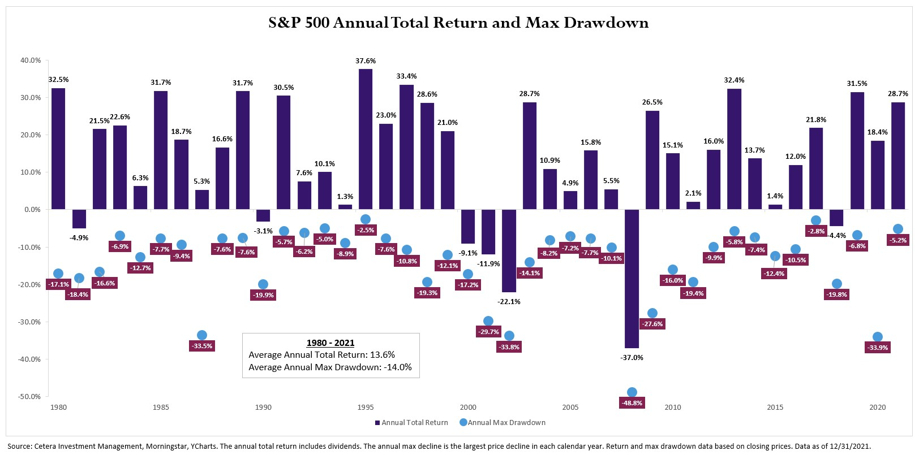
Market Corrections Are Common
Notes:
Powerful data about intra-year pullbacks, market corrections, and importance of long-term investing S&P 500 has risen in 35 of the past 42 years. In those years, the average intra-year loss is -14%. Market volatility and corrections are typical in bull markets.

Slide 17
Thank You
For more recent updates follow us on Twitter @CeteraIM
Notes:
A lot of times the general themes of economic outlooks do not change from quarter to quarter. This is true of the fourth quarter. We are continuing through the Fed rate hike cycle, looking for clues in economic data such as inflation data, paying close attention to what Fed officials are saying. We could be nearing the end of this Fed tightening cycle right now. The Fed was late to hike rates, thinking inflation was transitory, and now it is making up for lost time. The potential problem it faces is that inflation data is backward looking and there are signs inflation could slow faster in the future. The transitory aspects of the inflation may be working its way out of the system as manufactured goods prices are coming under disinflationary pressures. Shipping costs are lower due to falling oil prices and normalizing supply chains. Housing prices and car prices should ease as financing costs and inventories rise. Falling home prices should mean falling rents. Wheat prices are also falling, which should create downward pressure on food prices.
However, there is a lag in these pressures that we may not see for possibly another quarter or even year. This increases the risk that the Fed may be fighting inflation pressures that have already passed. Are they truly fighting the ghost of inflation? It may be too soon to tell, and the overall level of the Fed Funds rate is still modest. We don’t discount the inflationary pressures in the economy still, so the Fed has a tough task.
While we expect volatility to remain in both bonds and stocks, there are some positives in both broad asset classes. Stock valuations are cheaper compared to a year ago, and bonds offer more yield. Investors are compensated more for the risks and this could provide a better entry point for new investors or investors with some cash on the sidelines. Your Cetera financial professional can help you through these volatile times to keep you focused on your personal goals and objectives.
Thank you

Slide 18
Disclosures
About Cetera® Investment Management
Cetera Investment Management LLC is an SEC registered investment adviser owned by Cetera Financial Group®. Cetera Investment Management provides market perspectives, portfolio guidance, model management, and other investment advice to its affiliated broker-dealers, dually registered broker-dealers and registered investment advisers.
About Cetera Financial Group
“Cetera Financial Group” refers to the network of independent retail firms encompassing, among others, Cetera Advisors LLC, Cetera Advisor Networks LLC, Cetera Investment Services LLC (marketed as Cetera Financial Institutions or Cetera Investors), Cetera Financial Specialists LLC, and First Allied Securities, Inc. All firms are members FINRA / SIPC. Located at 655 W. Broadway, 11th Floor, San Diego, CA 92101.
Individuals affiliated with Cetera firms are either Registered Representatives who offer only brokerage services and receive transaction-based compensation (commissions), Investment Adviser Representatives who offer only investment advisory services and receive fees based on assets, or both Registered Representatives and Investment Adviser Representatives, who can offer both types of services.
The material contained in this document was authored by and is the property of Cetera Investment Management LLC. Cetera Investment Management provides investment management and advisory services to a number of programs sponsored by affiliated and non-affiliated registered investment advisers. Your registered representative or investment adviser representative is not registered with Cetera Investment Management and did not take part in the creation of this material. He or she may not be able to offer Cetera Investment Management portfolio management services.
Nothing in this presentation should be construed as offering or disseminating specific investment, tax, or legal advice to any individual without the benefit of direct and specific consultation with an investment adviser representative authorized to offer Cetera Investment Management services. Information contained herein shall not constitute an offer or a solicitation of any services. Past performance is not a guarantee of future results.

Slide 19
Disclosures
For more information about Cetera Investment Management, please reference the Cetera Investment Management LLC Form ADV disclosure brochure and the disclosure brochure for the registered investment adviser your adviser is registered with. Please consult with your adviser for his or her specific firm registrations and programs available.
No independent analysis has been performed and the material should not be construed as investment advice. Investment decisions should not be based on this material since the information contained here is a singular update, and prudent investment decisions require the analysis of a much broader collection of facts and context. All information is believed to be from reliable sources; however, we make no representation as to its completeness or accuracy. The opinions expressed are as of the date published and may change without notice. Any forward-looking statements are based on assumptions, may not materialize, and are subject to revision.
All economic and performance information is historical and not indicative of future results. The market indices discussed are not actively managed. Investors cannot directly invest in unmanaged indices. Please consult your financial advisor for more information.
Additional risks are associated with international investing, such as currency fluctuations, political and economic instability, and differences in accounting standards.
A diversified portfolio does not assure a profit or protect against loss in a declining market.
The S&P 500 is a capitalization-weighted index of 500 stocks designed to measure performance of the broad domestic economy through changes in the aggregate market value of 500 stocks representing all major industries.
The ICE BofA US High Yield Index tracks the performance of US dollar denominated below investment grade rated corporate debt publicly issued in the U.S. domestic market. To qualify for inclusion in the index, securities must have a below investment grade rating (based on an average of Moody's, S&P, and Fitch) and an investment grade rated country of risk (based on an average of Moody's, S&P, and Fitch foreign currency long term sovereign debt ratings). Each security must have greater than 1 year of remaining maturity, a fixed coupon schedule, and a minimum amount outstanding of $100 million.
The Russell 1000 index is a stock market index that tracks the top 1,000 stocks by market capitalization in the Russell 3000 Index, which represent about 90% of the total market capitalization of that index.
The Russell 2000 index is comprised of 2000 small-capitalization companies. It is made up of the bottom two-thirds in company size of the Russell 3000 index.

